Slide 1

Predicting Motor Insurance Claims: A Technical Implementation
A machine learning approach to risk-based underwriting, pricing optimisation, and operational efficiency using ensemble learning techniques and comprehensive feature engineering.

Slide 2

Business Objective and Strategic Value
Primary Goal
Strategic Benefits
Predict the probability of a motor insurance claim during the next policy period using historical policy, vehicle, and demographic data. This enables data-driven decision-making across the entire insurance value chain.
Risk-based underwriting with quantified probability scores
Dynamic pricing optimisation aligned to true risk exposure
Enhanced operational efficiency through predictive resource allocation
Improved loss ratios through accurate risk segmentation

Slide 3
Dataset Characteristics and Technical Context
Dataset Structure
Feature Categories
Technical Implication
Type: Structured tabular insurance data
Policy attributes (tenure, policyholder age)
The imbalanced nature of insurance claims data requires specialised modelling techniques and evaluation metrics. Standard accuracy measures would be misleading; instead, we prioritise ROC-AUC and precision-recall trade-offs.
Target Variable: is_claim (binary classification)
Vehicle specifications (engine, power, torque, weight)
Class Distribution: Imbalanced with claims representing the minority class
Safety features (airbags, ESC, TPMS, NCAP rating)
Geographic indicators (area cluster, population density)

Slide 4
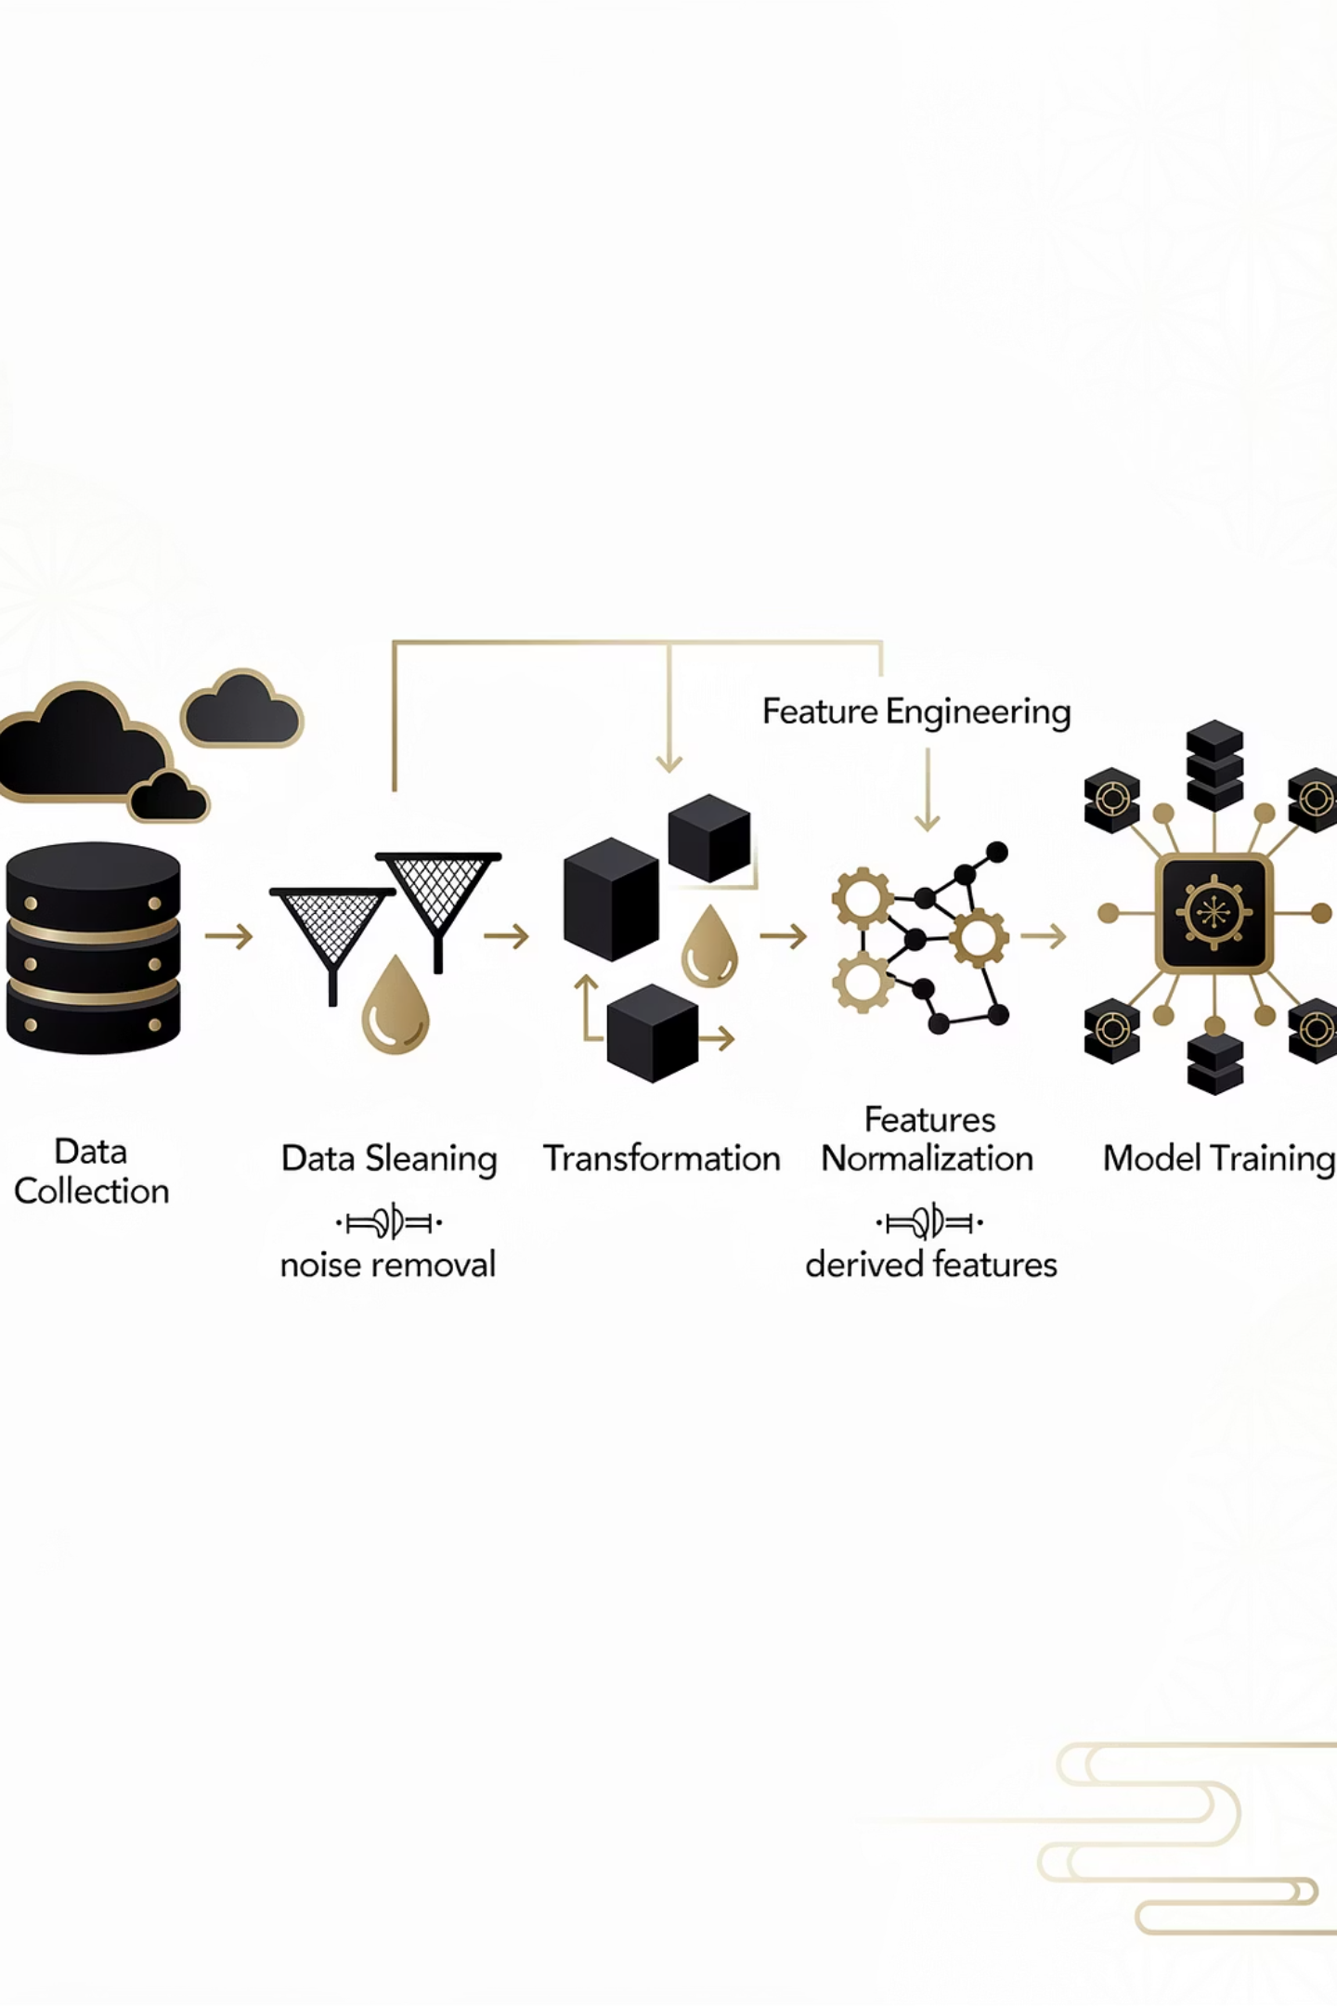

Data Preprocessing and Feature Engineering Pipeline
01
02
Data Cleaning and Transformation
Encoding Strategy
Converted categorical Yes/No indicators into binary numeric format. Parsed unstructured engine specifications (max_power, max_torque) into numeric values with corresponding RPM. Removed non-predictive identifiers such as policy_id.
Applied Label Encoding to high-cardinality categorical features. Stored encoders as serialised artifacts (.pkl) for inference consistency, ensuring identical preprocessing during training and deployment.
03
Interaction Feature Engineering
Derived features to capture non-linear risk relationships: power-to-weight ratio (proxy for driving aggressiveness), torque-to-weight ratio (vehicle acceleration behaviour), car age vs policy tenure ratio, and engine efficiency proxy.
Business Benefit: Guarantees prediction reliability in production through consistent preprocessing and feature engineering across training and inference pipelines.

Slide 5

Modelling Approach: Algorithms and Strategy
Advanced Ensemble Models
Why Ensemble Methods?
Ensemble learning techniques offer significant advantages for insurance risk modelling. They handle mixed feature types effectively, capture complex non-linear interactions between risk factors, and demonstrate robustness to noise and multicollinearity in the data.
Random Forest
XGBoost
CatBoost
These characteristics are particularly valuable in insurance contexts where risk drivers often interact in unpredictable ways and data quality varies across sources.

Slide 6
Cross-Validation and Class Imbalance Handling
Stratified K-Fold Cross-Validation
Class Imbalance Mitigation
Implemented 5-fold stratified cross-validation to preserve claim distribution across all folds. Each fold was evaluated using ROC-AUC to ensure consistent performance measurement.
Applied multiple techniques tailored to each algorithm:
class_weight='balanced' for Random Forest
scale_pos_weight parameter for XGBoost
Business Alignment: Ensures stable performance across different customer segments and geographic distributions.
Custom class weights for CatBoost
Outcome: Improved recall on high-risk claim cases without sacrificing precision, enabling better identification of potential claims whilst maintaining underwriting confidence.

Slide 7
Model Evaluation Framework
Metric
Technical Purpose
Business Interpretation
ROC-AUC
Primary evaluation metric
Ability to rank risky vs safe customers effectively
Precision
Positive predictive value
Confidence in high-risk flags and pricing decisions
Recall
True positive rate
Coverage of actual claim cases for risk management
F1-Score
Harmonic mean
Balance between precision and recall for operational efficiency
1
Model Comparison
2
Final Model Selection
3
Generalisation Confidence
Compared mean cross-validated AUC across all candidate models to identify the best-performing ensemble approach.
Selected the highest-performing model and retrained on the full dataset before deployment to maximise predictive power.
Rigorous cross-validation ensures the model generalises well to unseen data and avoids overfitting to training patterns.

Slide 8
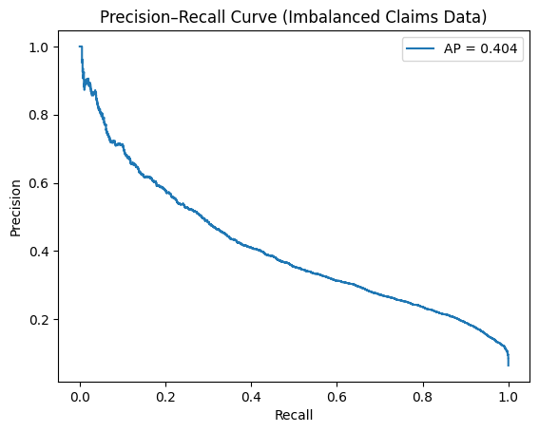
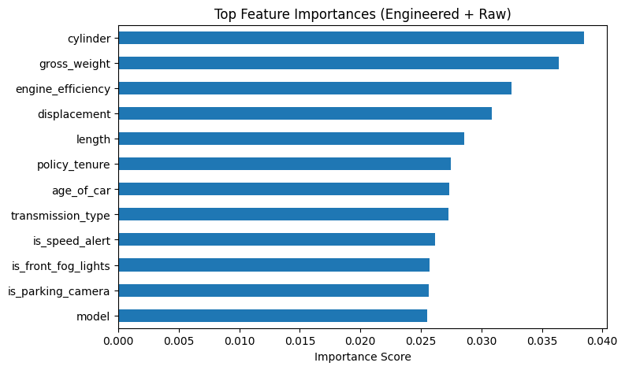
Visualizations
The Precision–Recall curve shows that the model can reliably identify the riskiest policies with high confidence, while providing a controllable trade-off between missed claims and false alarms—making it suitable for underwriting and operational risk decisions.
The feature importance plot confirms that the model’s decisions are driven by mechanically and behaviorally meaningful factors, with engineered efficiency metrics adding substantial predictive value without overpowering raw vehicle characteristics.

Slide 9
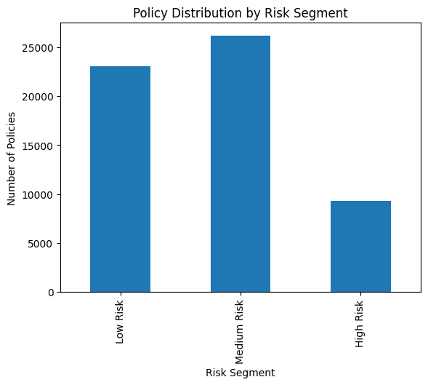
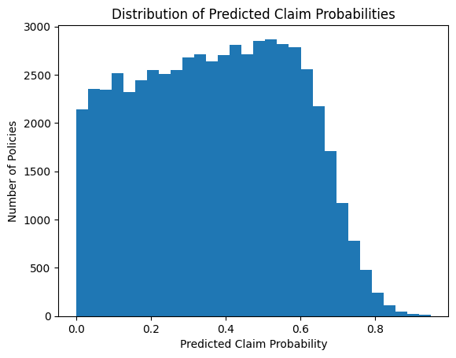
Visualizations
The risk segmentation chart shows a healthy insurance portfolio structure, with most policies classified as low-to-moderate risk and a focused high-risk segment that can be actively managed for loss control.
The predicted probability distribution demonstrates that the model produces a realistic and well-spread risk landscape, enabling effective underwriting decisions without overconfidence or risk dilution.

Slide 10
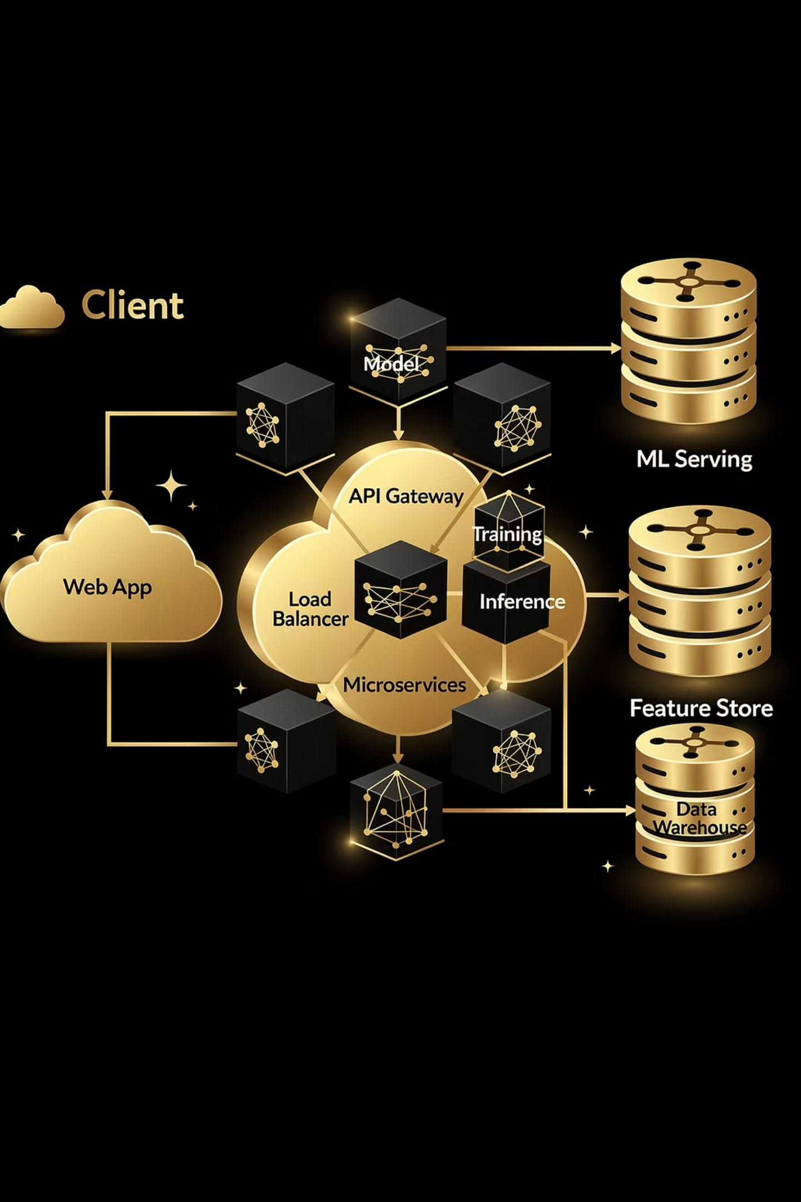




Production Deployment Architecture
User Input Interface
Streamlit application captures encoded categorical features and numeric vehicle and policy details through an intuitive web interface.
Real-Time Feature Engineering
Inference pipeline applies identical transformations and feature engineering logic used during training, ensuring strict feature order alignment.
Model Prediction
Trained ensemble model generates risk probability scores with saved artifacts including the model file and label encoders.
Output Delivery
Results delivered through Streamlit interface, currently hosted via ngrok with production-ready architecture for AWS or Azure migration.

Slide 11
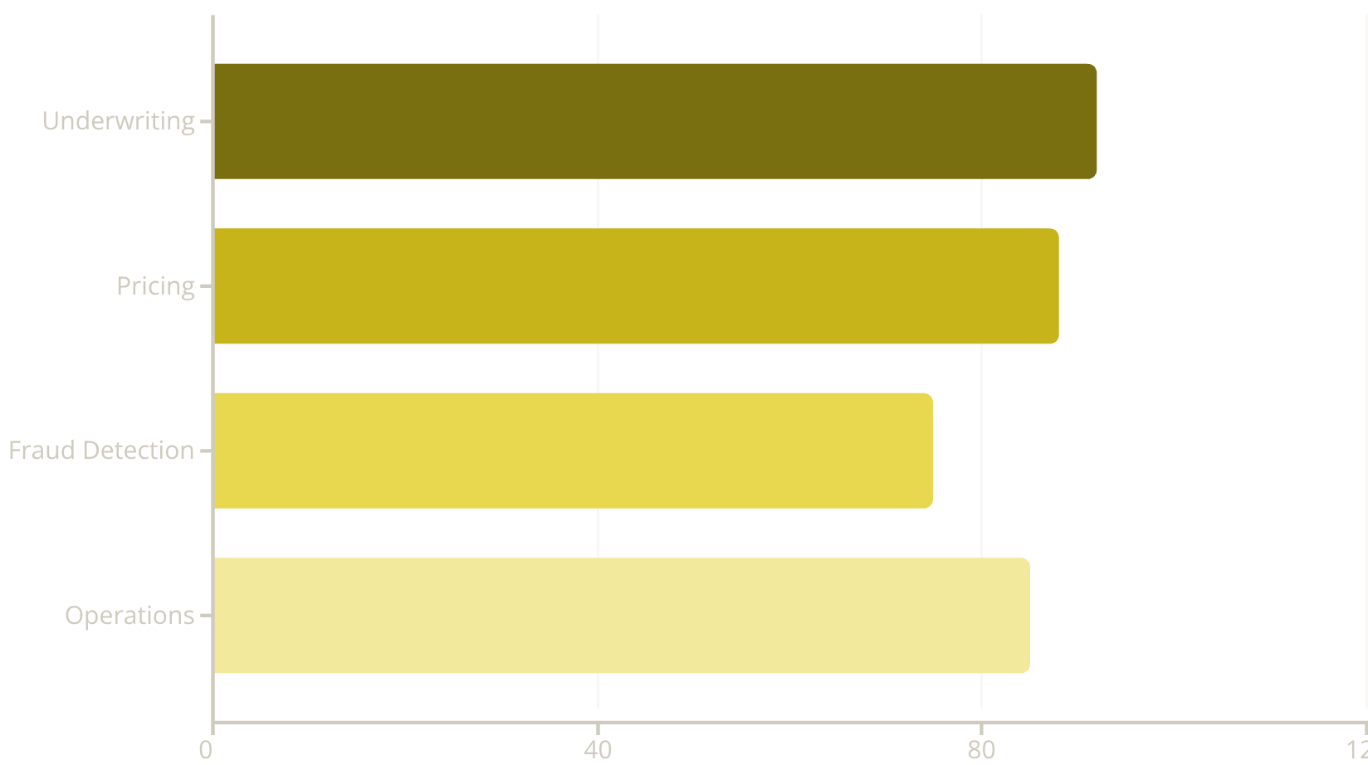

Business Impact and Model Explainability
Key Business Outcomes
Underwriting: Risk probability scoring reduces loss ratio through better risk selection
Pricing: Predictive risk modelling enables fair, data-driven premiums
Fraud Detection: High-risk segmentation supports early intervention strategies
Operations: Claim forecasting optimises resource allocation and reserves
Model Explainability: Feature importance analysis validates that safety features reduce claim probability whilst vehicle age and performance increase risk. This alignment with insurance domain knowledge provides regulatory transparency and auditability.

Slide 12
Limitations and Future Technical Enhancements
Current Limitations
Long-Term Vision
Model limited to historical data patterns; concept drift possible over time
Automated retraining pipelines with MLOps framework
No temporal claim severity modelling incorporated
Cloud-native deployment with CI/CD integration
External risk factors (weather, economic indicators) not included
Real-time model monitoring and drift detection
1
2
3
Near-Term Enhancements
Probability calibration using Platt or Isotonic scaling
SHAP-based global and local explainability
Claim severity regression model development
Executive Takeaway
This project delivers a production-ready insurance risk prediction system combining advanced ensemble learning, robust feature engineering, and business-aligned evaluation metrics. The solution enables data-driven underwriting, optimised pricing strategies, and operational efficiency improvements across the insurance value chain.

